Slide 1
Sigmund Freud
Subtitle

Slide 2
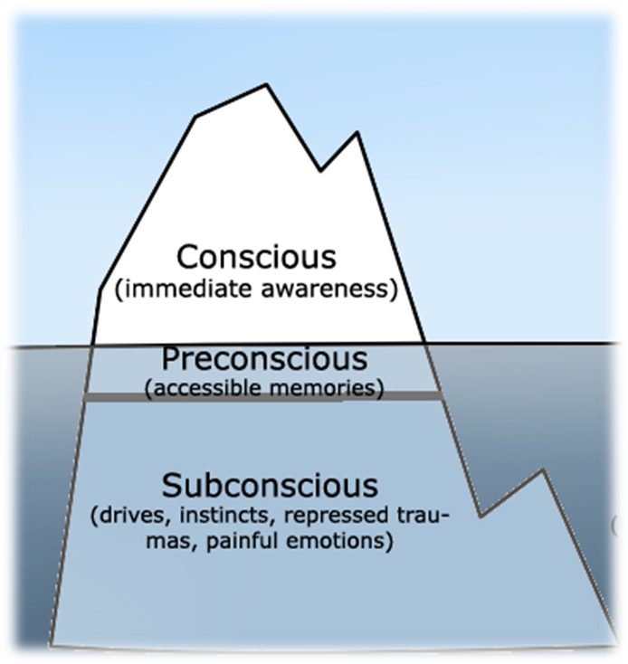
Level of consciousness/mind
Unconsciousness
Preconsciousness
Consciousness

Slide 3
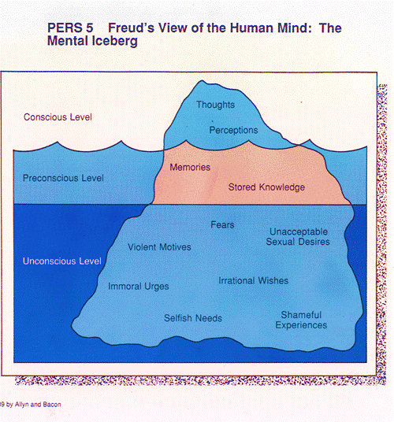

Slide 4
Levels of Mind
Consciousness: It contains all of the current thoughts, feelings, and wishes of which we are aware at any given moment. It includes what you are thinking about right now.
Sub-consciousness: It is the storage point for any recent memories needed for quick recall, such as what your telephone number is or the name of a person you just met. It also holds current information that you use every day, such as your current recurring thoughts, behavior patterns, habits, and feelings.

Slide 5
Levels of Mind
3. Unconsciousness:
The unconscious mind is where all of our painful memories, desires, wishes and past experiences reside. These are those memories that have been repressed through trauma and those that have simply been consciously forgotten and no longer important to us (automatic thoughts). It’s from these memories and experiences that our beliefs, habits, and behaviors are formed.

Slide 6
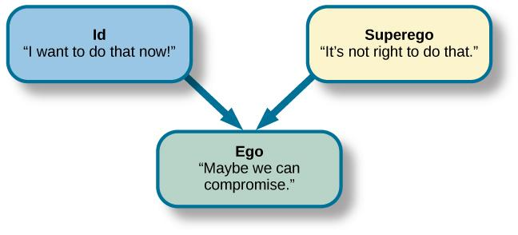
Personality structure

Slide 7
Structure of Personality
1. ID
Based on Pleasure principle
Newborn child is all id
Not in touch with the external world
Not affected by reality, logic or the everyday world, as it operates within the unconscious part of the mind.
Id is illogical, demanding, and blind.
Id is the unconscious part of the mind; that act instantaneously without giving much thought to what is right and what is wrong.

Slide 8
Structure of Personality
2. Ego
Based on reality principle
Develops in infancy
Mediate between the unrealistic id and the external real world.
Decision making component of personality.
Ego has no concept of right or wrong
It achieves its end of satisfying without causing harm to itself or to the id.
Ego is the logical and the conscious part of the mind
It balances the demands of Id and super-ego in the context of real life situations.
Ego is conscious and hence keep a check on Id through a proper reasoning of an external environment.

Slide 9
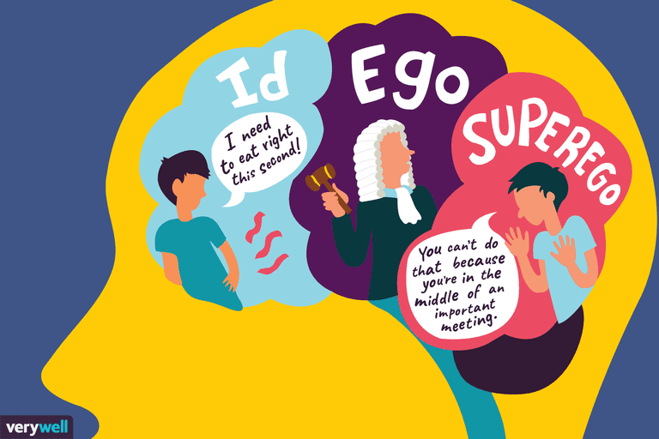

Slide 10
Structure of Personality
3. Superego
Based on morality principle
Develops around the age of 3 – 5
The Super-Ego is related to the social or the moral values that an individual inculcates as he matures.
It acts as an ethical constraint on behavior and helps an individual to develop his conscience.
As the individual grows in the society, he learns the cultural values and the norms of the society which help him to differentiate between right and wrong.

Slide 11
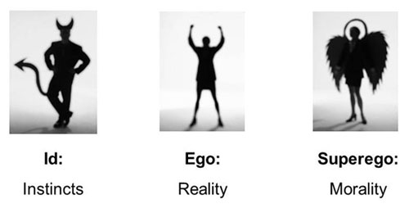
holds all of our internalized moral standards and ideals
our sense of right and wrong.
provides guidelines for making judgments.

Slide 12
ID: Operates on pleasure principle.
EGO: Responsible for dealing with the reality.
SUPER EGO: Holds all the internalized moral standards and ideals.

Slide 13
Example
Smoking
ID: The desire to smoke.
EGO: The fear of harm it could cause.
SUPER EGO: Guilt for going against your moral values.

Slide 14
TYPES OF DEFENSE MECHANISMS
Repression
Projection
Displacement
Sublimation
Denial
Regression
Undoing

Slide 15
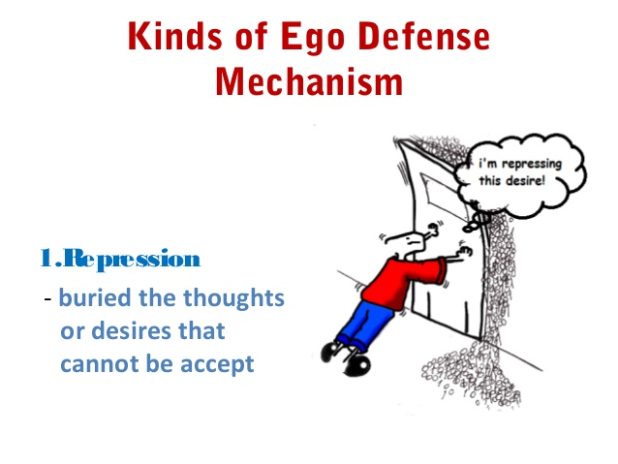
Repression
Most important defense mechanism.
It banishes painful memories or thoughts from consciousness to minimize anxiety.
Putting things into darkness.
Repression is an unconscious mechanism employed by the ego to keep disturbing or threatening thoughts from becoming conscious. Thoughts that are often repressed are those that would result in feelings of guilt from the superego.
Example:

Slide 16
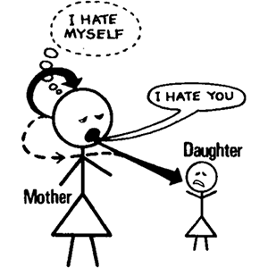
2. Projection
Involves individuals attributing their own unacceptable thoughts, feelings and motives to another person.
Or seeing your own faults in others.
Example: You might hate someone, but your superego tells you that such hatred is unacceptable. So you 'solve' this problem by believing that they hate you.

Slide 17
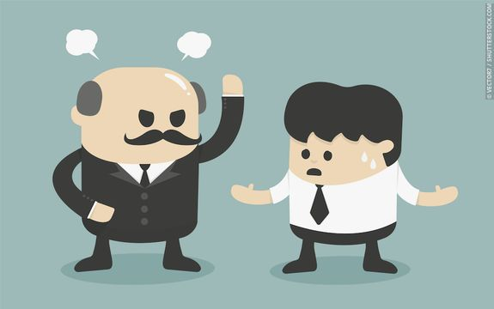
3. Displacement
It is the redirection of an impulse onto a powerless substitute target.
To take anger out on somebody else.
Example: Someone who is frustrated by his or her superiors (boss) may go home and kick the dog, or beat up a family member.

Slide 18
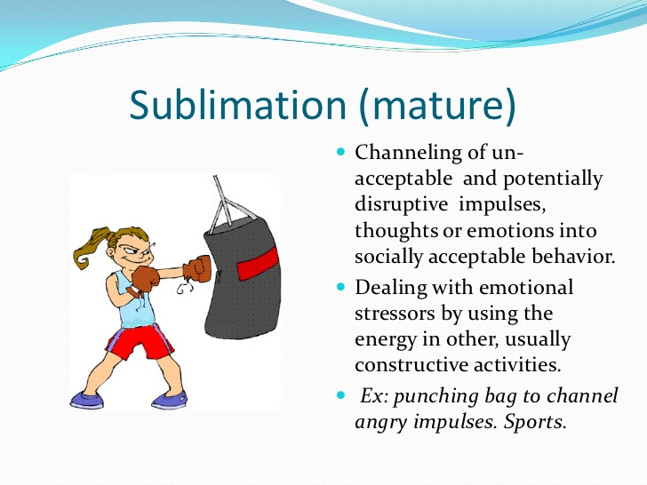
4. Sublimation
This is similar to displacement.
Takes place when we manage to displace our emotions into a constructive rather than destructive activity.
Diverts negativity into acceptance.
Examples: Many great artists and musicians have had unhappy lives and have used the medium of art of music to express themselves.
Sport is another example of putting our emotions (e.g. aggression) into something constructive.

Slide 19
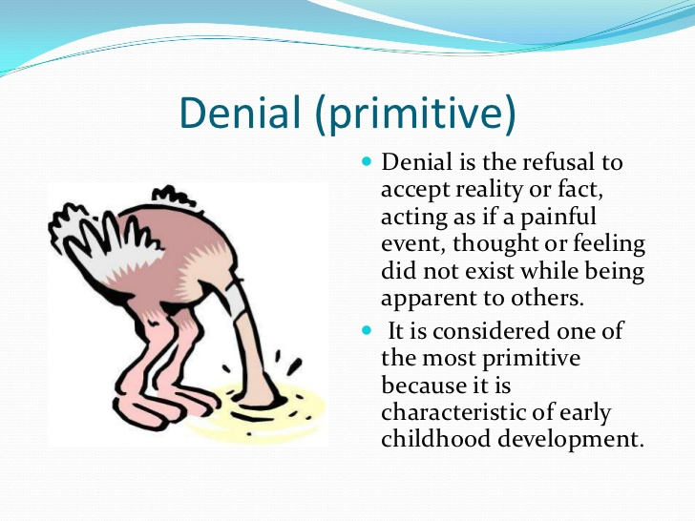
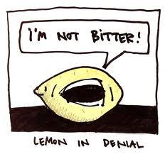
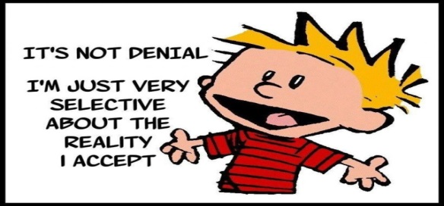
5. Denial
It involves blocking external events from awareness.
If some situation is just too much to handle, the person just refuses to experience it.
As you might imagine, this is a primitive and dangerous defense - no one disregards reality and gets away with it for long. It can operate by itself or, more commonly, in combination with other, more subtle mechanisms that support it.
Refusing to face negative behavior.
Examples: Smokers may refuse to admit to themselves that smoking is bad for their health.
Or girls might refuse to admit that they wear too much makeup.

Slide 20
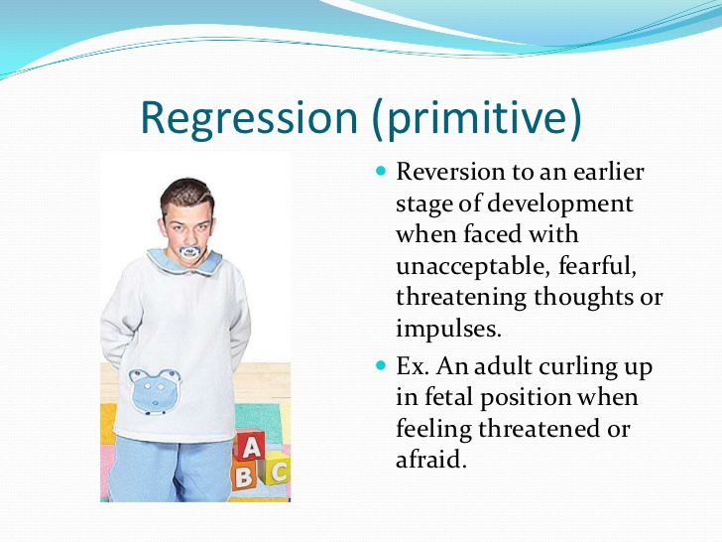
6. Regression
It involves returning to a behavior pattern or a characteristic of an earlier stage of development. Acting much younger to feel better.
Example: Teenagers may giggle uncontrollably when introduced into a social situation involving the opposite gender.

Slide 21
7. Undoing
Undoing is the attempt to take back an unconscious behavior or thought that is unacceptable or hurtful.
For instance, after realizing you just insulted your significant other unintentionally, you might spend then next hour praising their beauty, charm and intellect - (“undoing”)of the previous action.

